Slide 1
Adilas Lite
Progress Report

Slide 2
10,000 ft Overview

Slide 3
Our Process

Slide 4
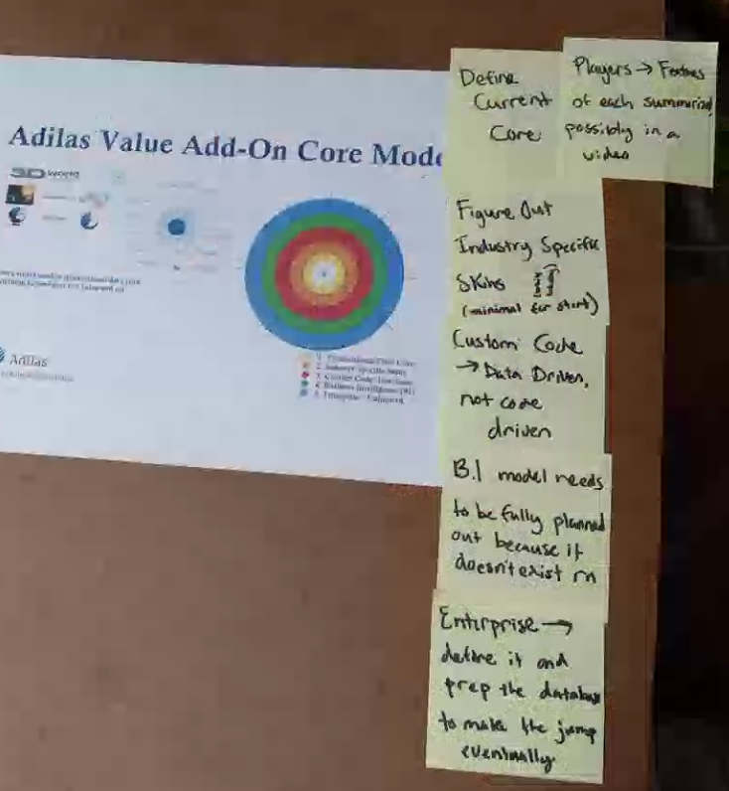
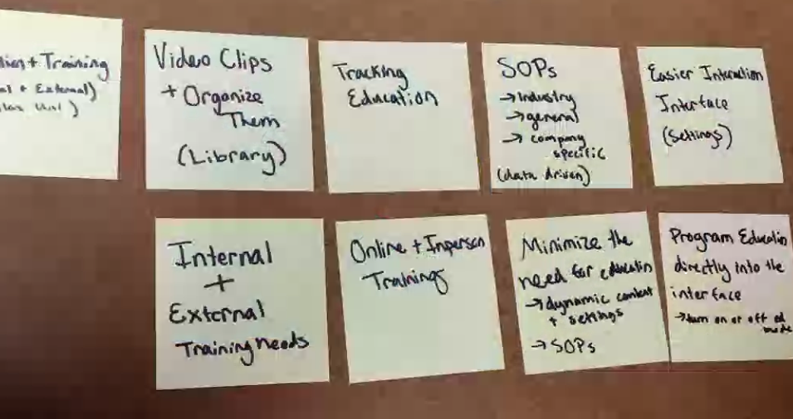
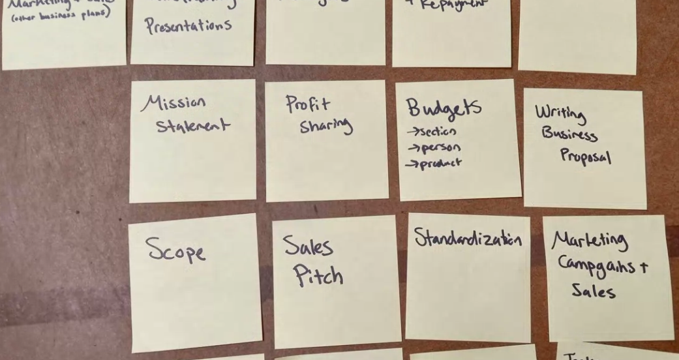
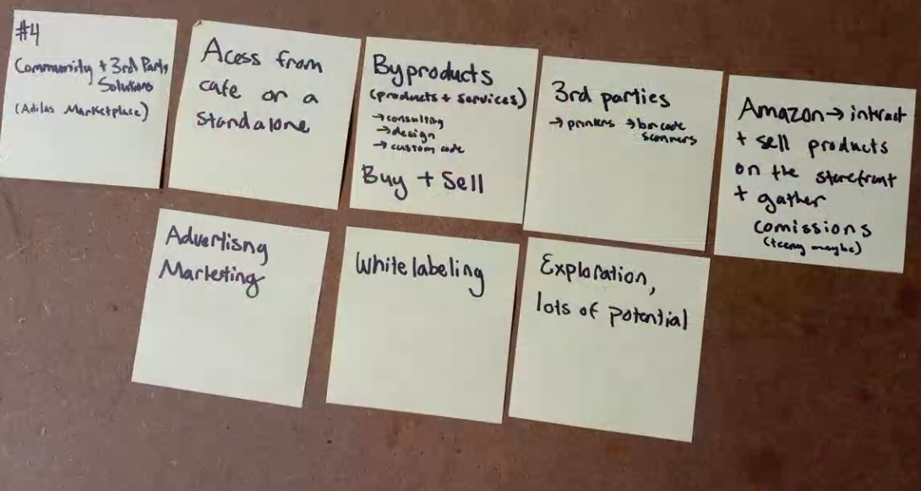
Organizing Things

Slide 5
Only Expose the Snow Cap Peaks

Slide 7
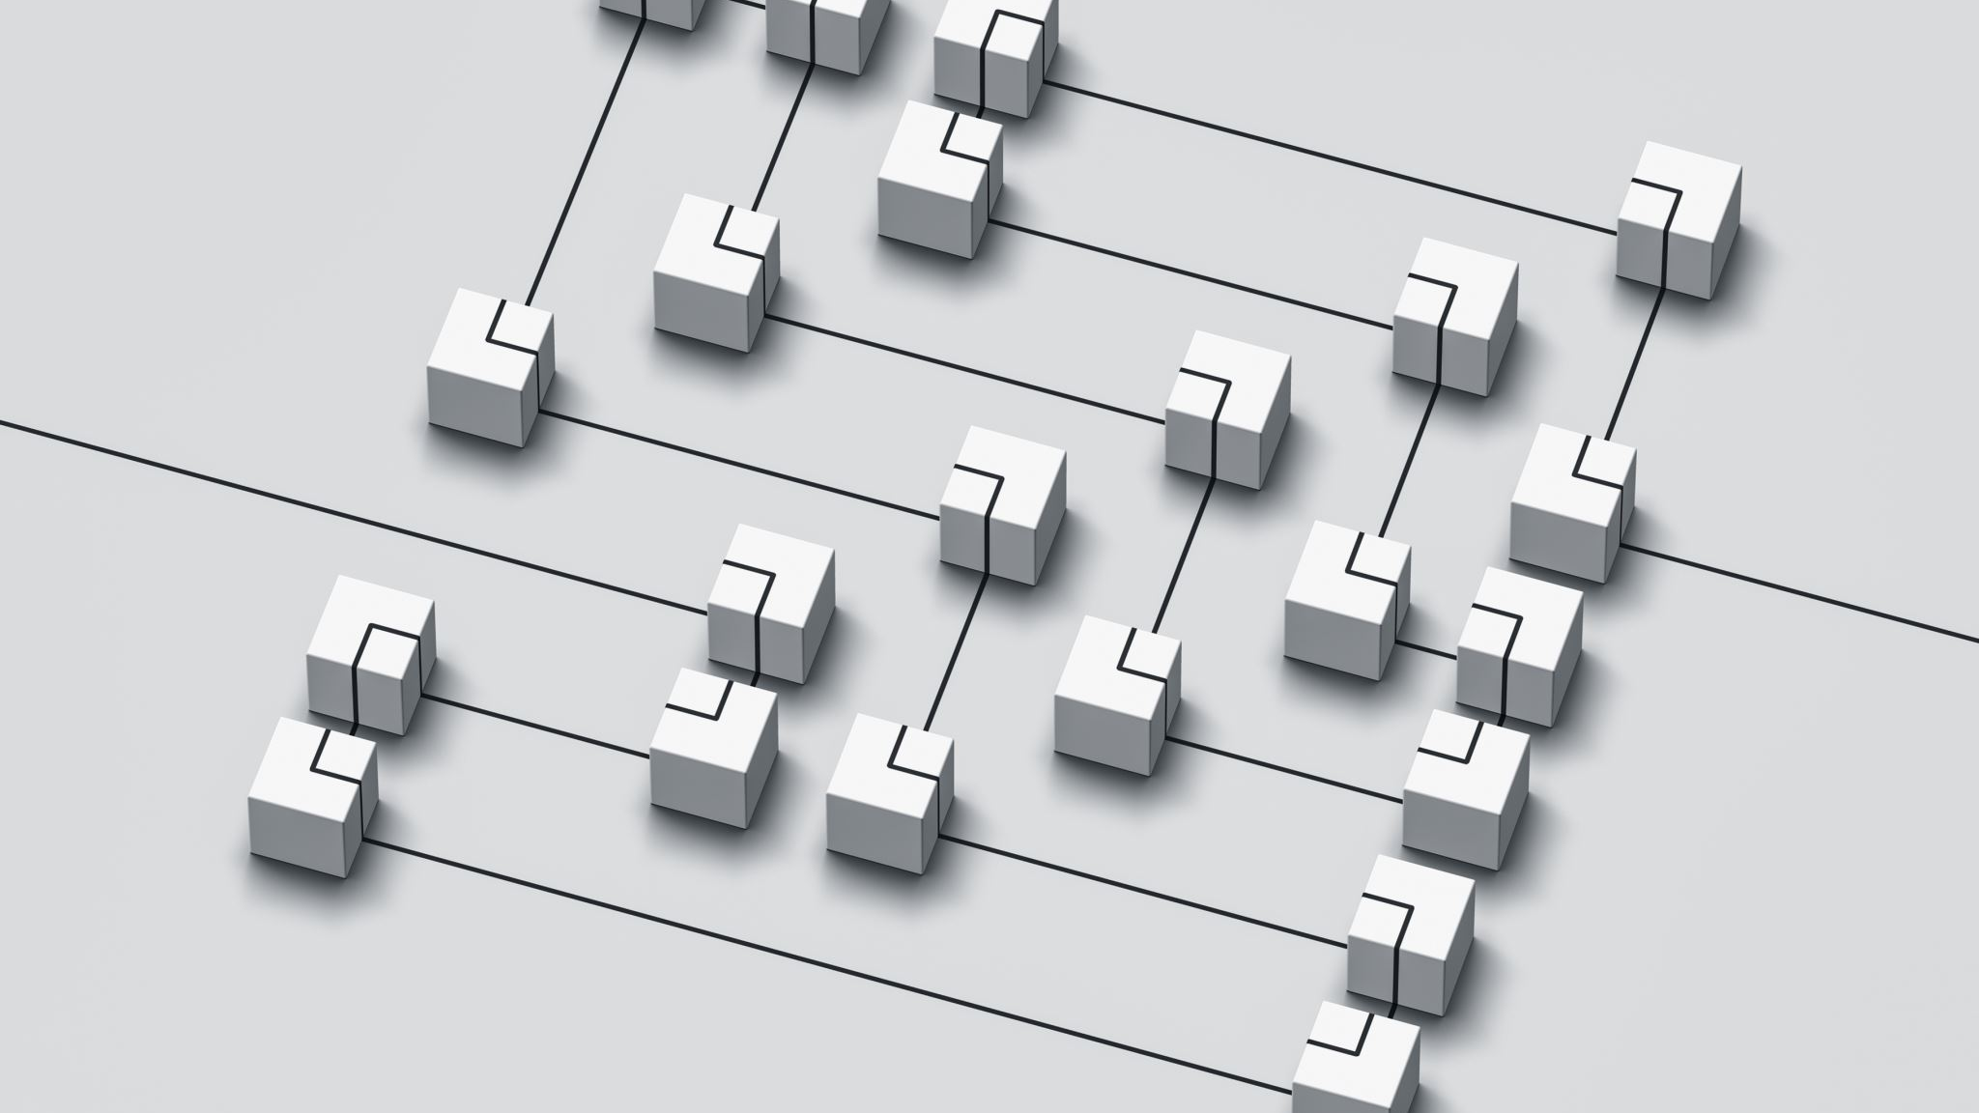
Price Structure

Slide 8
Tiered Versions
Free
Basic
Standard
Pro
Enterprise

Slide 9
Pricing Matrix
 | Free | Basic | Standard | Pro | Enterprise
Users | 1 | 2 | 10 | Unlimited | Unlimited
Invoice Count | 1-15 | 50 | 500 | Unlimited | Unlimited
Total Sales | $5,000 | $20,000 | $200,000 | Unlimited | Unlimited
Customers | 100 |  | Unlimited | Unlimited | Unlimited
Items/Products | 50 |  | 1,000 | Unlimited | Unlimited
Locations | 1 |  | 10 | Unlimited | Unlimited
Hosting Size | shared | shared | Shared, semi-dedicated | Semi-dedicated, dedicated, clustered | Dedicated, clustered
Storage Size | 2 GB | 20 GB* | 50 GB* | Unlimited | Unlimited
*Option to upgrade for more storage

Slide 10
Feature Matrix
Features | Free | Basic | Standard | Pro | Enterprise
Basic Customers | X | X | X | X | X
Additional Customer Contacts |  | X | X | X | X
Customer Logs/Notes | X | X | X | X | X
Files/Content |  | X | X | X | X
Accounts Receivable |  |  | X | X | X
Shopping Cart | X | X | X | X | X
Discounts | X | X | X | X | X
Loyalty Points |  | X | X | X | X

Slide 12
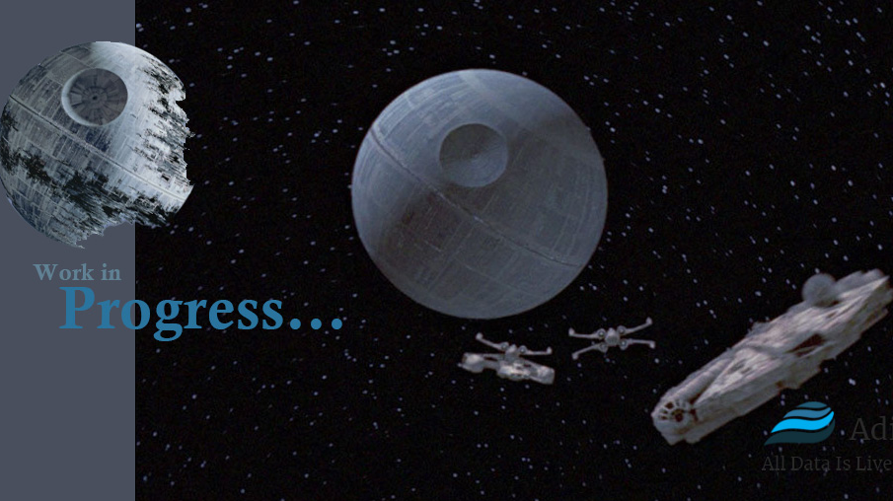

Slide 14
Frameworks/Libraries

Slide 15
Company Structure

Slide 16
Adilas – Admin/Billing
RETAIN
Training/Setup
Customer Support
Consulting
Adilas University
GROW
Sales
Marketing
Advertising
CODE
Project Management
Design
Development
Testing
Custom
Bugs
IT
Servers
Database
Security
Hosting
Cafe
Marketplace
and other money generating opportunities

Slide 18
Mission Statement

Slide 19
Ideas
plan it out, build it out, test it out, report it out, train it out, sell and market it out – every feature, every time
All Data is Live and Searchable
secure, reliable, easy, simple, configurable, dynamic, the whole system under one roof, only access what you need.
Easy, reliable, customizable data access
Easy, powerful and pretty
High-end software as a service (SaaS) model, specializing in operations and accounting. We offer a standard package and then customize on top of that.

Slide 20
Each Department has a vision
Sales
Training
Code
IT
Market Place

Slide 21
User Stories

Slide 22
Where do you want to play?

