Slide 1

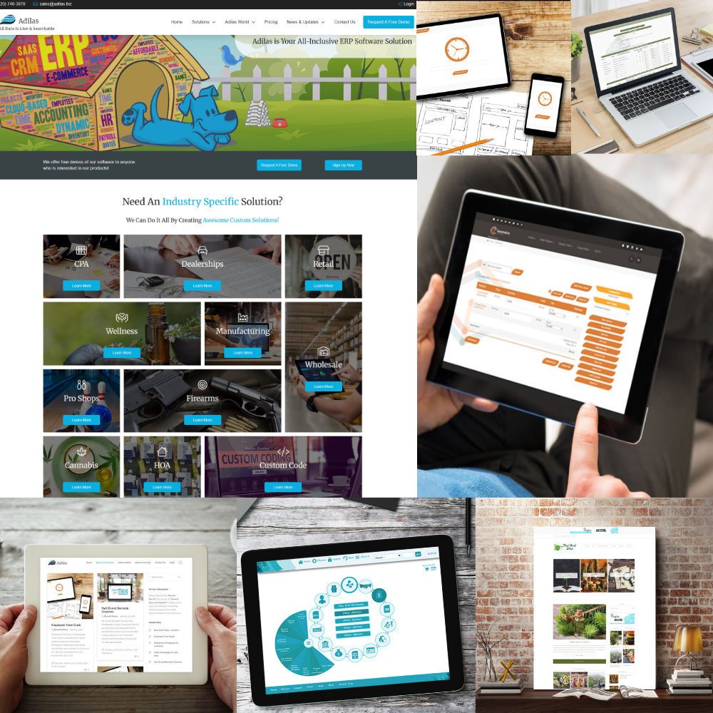

What Do
We Offer?
Online – Web-based
Software as a Service
Operations
Accounting
Standard Package
Custom Code
Start Small → Expand
Great Pricing

Slide 2
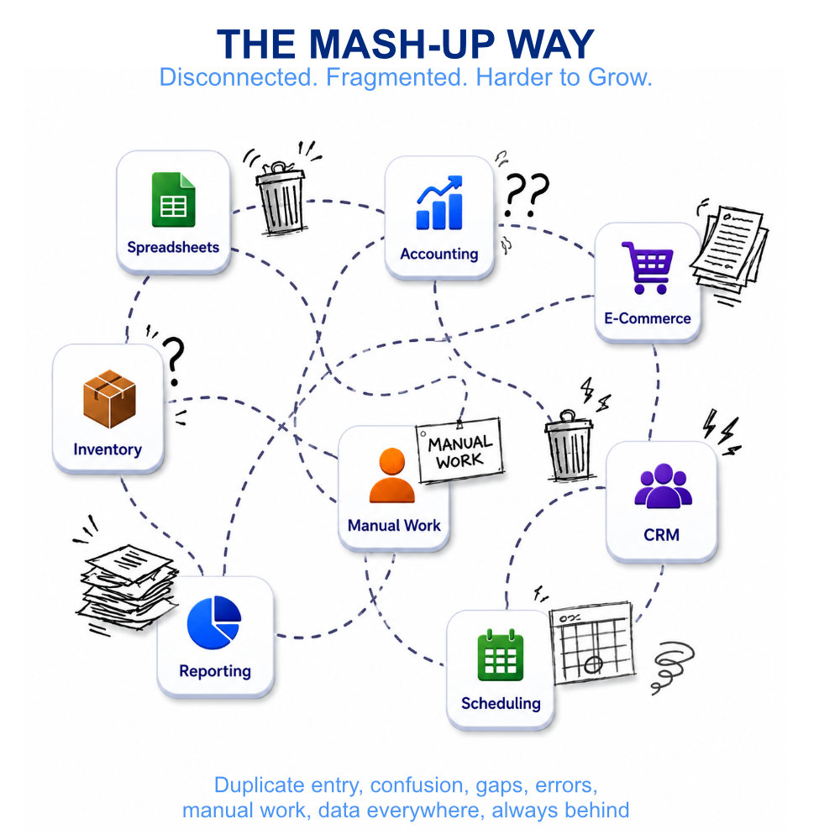
Common
Practices
Disconnected Systems
Data All Over The Place
Batching & Time Gaps
Dead Ends
Duplicate Data
Legacy Systems
Manual Processes
Hopefully Gets United??

Slide 3
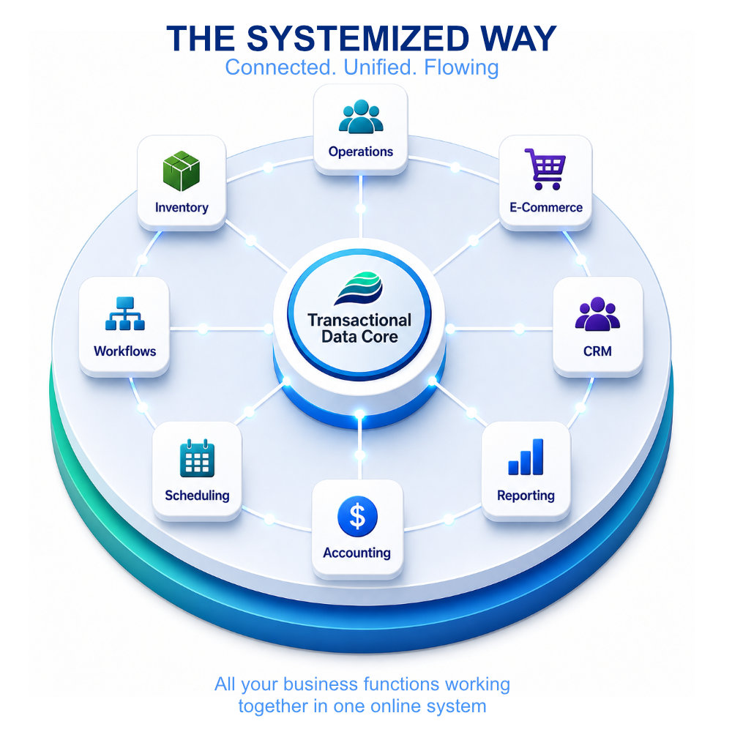
How Adilas
Works!
Kick-butt Data Engine
Interconnected Pieces
Relationships
Business Logic
Transactional Data Core
Configurable
Expandable
You Get It All!

Slide 4
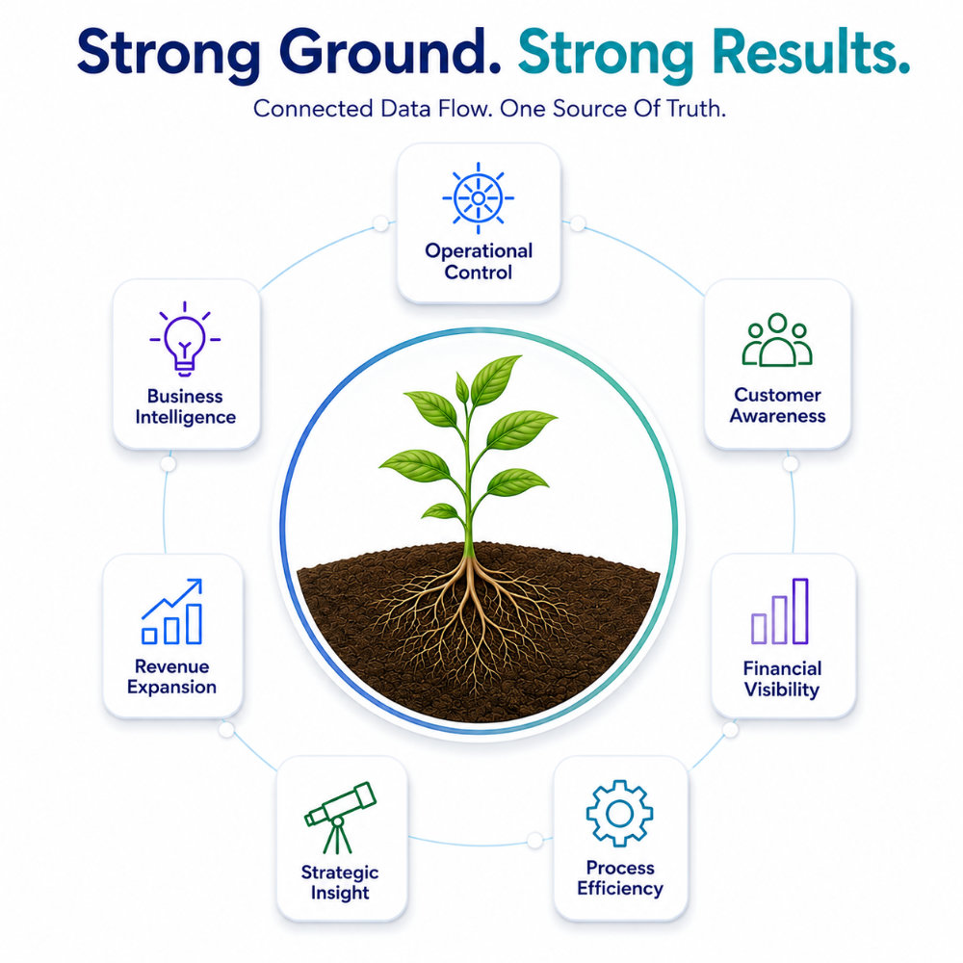
Desired
Outcomes
Operational Control
Customer Awareness
Financial Visibility
Process Efficiency
Business Intelligence
Strategic Insight
Accountability
Revenue Expansion

Slide 5
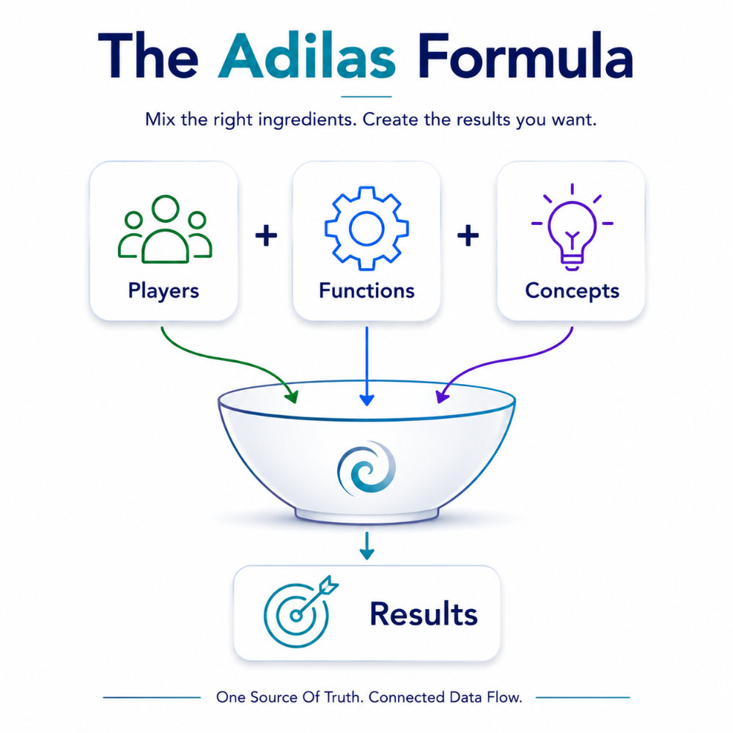
Concepts &
Recipes
Industry Recipe Maps
Use Players
Mix Functions
Apply Concepts
Create Results
To get results, you have
to start mixing.
Visit www.adilas.biz

